Slide 1
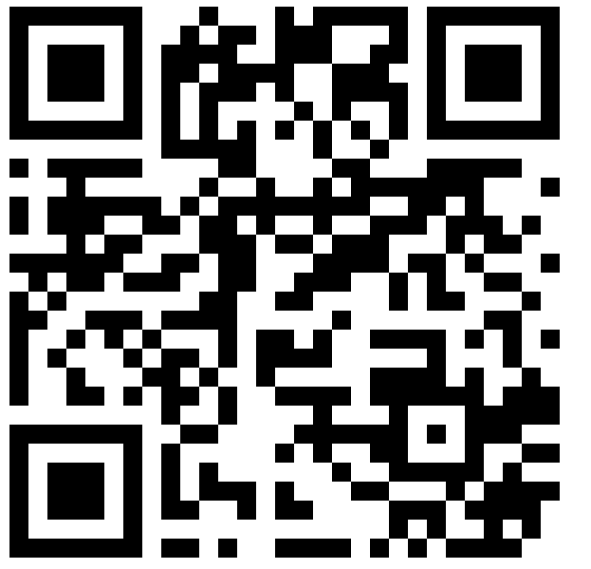
Protecting Water Resources for
THE NEXT SEVEN GENERATIONS
Join us for a SPIN Club focused on water quality and natural resources. In partnership with the Little Traverse Bay Band of Odawa Indians staff, you will learn from the professionals on what it takes to keep our world green and our waters safe.
FOR AGES 12-19. COST IS $5 PER YOUTH
Amanda Foster
4-H Program Coordinator
Office: 231-439-8974
E-Mail:
Furgeso3@msu.edu
Register here-
Registerathttps://v2.4honline.com/#/user/sign-in
Join Club- Statewide 4-H Club- Emmet County to register.
Tree Planting for Stream Restoration
May 6, 2023, 1:00 – 3:00PM
Location- Biindigen Gas Station
Water Quality On The LAKE
June 3, 2023, 1:00 –2:30PM
Location- Spring Lake Park (alt. Petoskey Waterfront)
Accommodations for persons with disabilities may be requested by contacting Amanda Foster at 231-439-8974 and will be fulfilled when possible, with enough notice.
Plant & Tree Identification Walk
June 24, 2023, 1:00 – 2:30PM
Location- Behind NCMC Gym Building
Wetlands & Natural Resource Careers
July 8, 2023, 1:00 – 2:30 PM
Location- Round Lake Nature Preserve

