Slide 1
Petoskey High School Early College
A Partnership Between
Petoskey High School
&
North Central Michigan College

Slide 2
What is Early College?
Student receives high school diploma and North Central Associate Degree* at the end of student’s 5th year (13th grade)
*Associate of Arts, Associate of Science, Associate of General Studies

Slide 3
Benefits of PHS Early College?
Free North Central tuition
Free college text books
Earn a college degree in accelerated pace
A North Central academic advisor and personalized support services
Access to college activities and events
Location – Right in your backyard!

Slide 4
Who can participate in Early College?
2021-2022 Sophomores
Have at least a 2.7 grade point average
Have qualifying PSAT or ACCUPLACER Test Scores
PSAT Score report should be turned in with your paper applications
Completed application (NCMC and High School)
Two letters of recommendation (typically a teacher)
Student essay
** Any serious athlete considering to continue with their sport in college should not consider the Early College program

Slide 5
What does Early College look like?
Students will be enrolled in high school for five years
Second, Third, and Fourth year a combination of concurrent (college classes at the high school) and dual enrolled (college classes at the college campus)
Fifth year will be completely at the college campus while completing the final math experience class required for MMC

Slide 6
What does Early College look like?
During the Second, Third and Fourth year, students will be allowed
To participate in all school activities and to walk in high school graduation ceremony (without receiving diploma)
During the Fifth year, students will be allowed
Will participate in North Central graduation ceremony
Will receive their high school diploma from PHS
Can and should apply for local, national, and college based scholarships

Slide 7
Schedule at a Glance
Sophomore Fall | Sophomore Winter
 | SD 125 First Year Experience
Junior Year Fall | Junior Year Winter
ENG 111 English Composition I | ENG 112 English Composition II
Potential for Additional College Class | Potential for Additional College Class
Senior Year Fall | Senior Year Winter
3 classes at NCMC | 3 classes at NCMC
5th Year Fall | 5th Year Winter
4-5 Classes at NCMC | 4-5 Classes at NCMC

Slide 8
What is the timeline for Early College?
Tonight!! Applications Available
December 10, 2021 Application Due!
December 17, 2021 Notice of Acceptance
January 11, 2022 Commitment to Attend
January 11, 2022 Mandatory Parent Meeting
January 12, 2022 SD 125 Registration
January 24, 2022 SD 125 Begins
April, 2022 Fall 2022 Class Registration

Slide 9
Become A Timberwolf Today!
Questions?

Slide 10
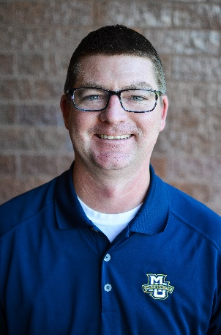
North Central Contact
Corey Lansing
Director of Admission
clansing@ncmich.edu

